Slide 1
LOAN SMART Mason Portman Jack Fitzgerald Svea Sharaf Libby Berter
Our Mission:
Develop a tool to aid both lender & borrower in making loan decisions
In today’s world:
22.5 million Americans with personal loans
$222 billion worth of loans

Slide 2
The data
Credit Risk data set from Kaggle was utilized for the project
Contained loan information such as:
Age
Income
Home ownership
Loan amount
Loan use
Loan default status
And more….

Slide 3
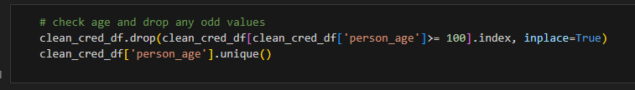

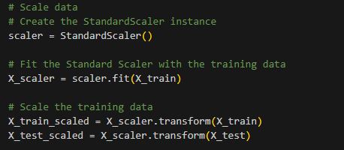
The prep Data prep for utilization in model building
Data prep for utilization in model building
Removed null values
Removed obvious outliers
Modified default status from y/n to 0/1
Utilized ‘Get Dummies’ to convert categorical data to numeric
Created test & train datasets and scaled the data using StandardScaler

Slide 4
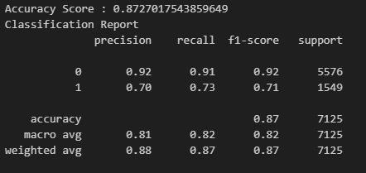
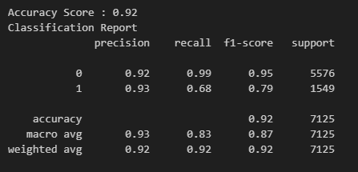
The model Utilized supervised learning to predict loan outcome
Compared results from 5 models
Decision Tree
Logistic Regression
SVC
KNN
Random Forest
Targeted a high precision on loans not defaulting
Decision Tree
Random Forest

Slide 5
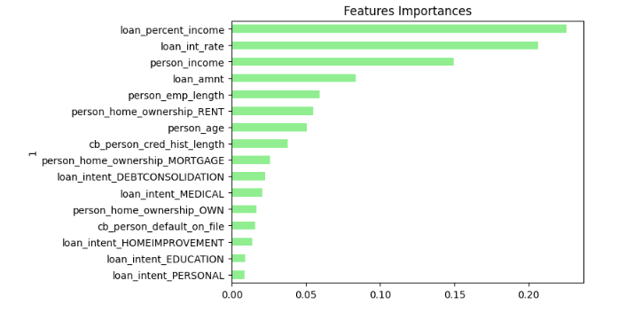
The Optimization
Removed statistical outliers
Utilized different parameters for the models
Kernal types
Solver types
# of neighbors, etc
Dropped columns based on feature importances

